Slide 1
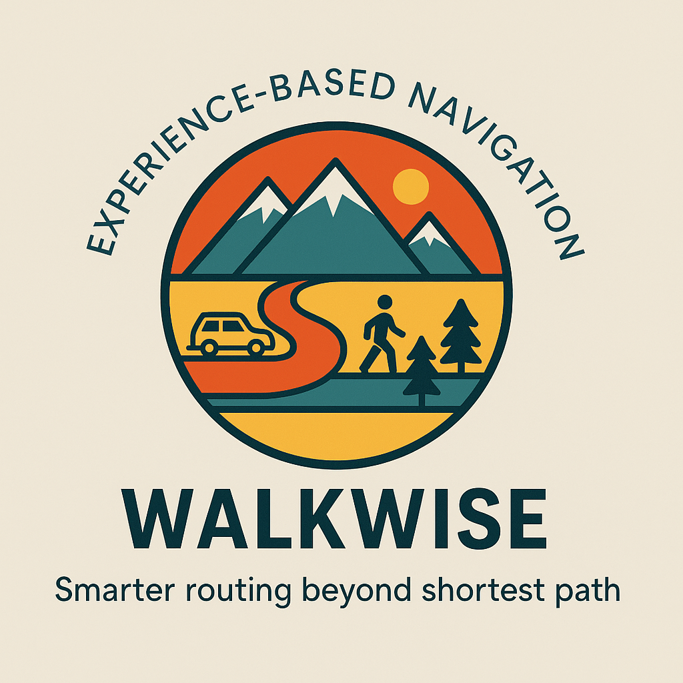

Slide 2
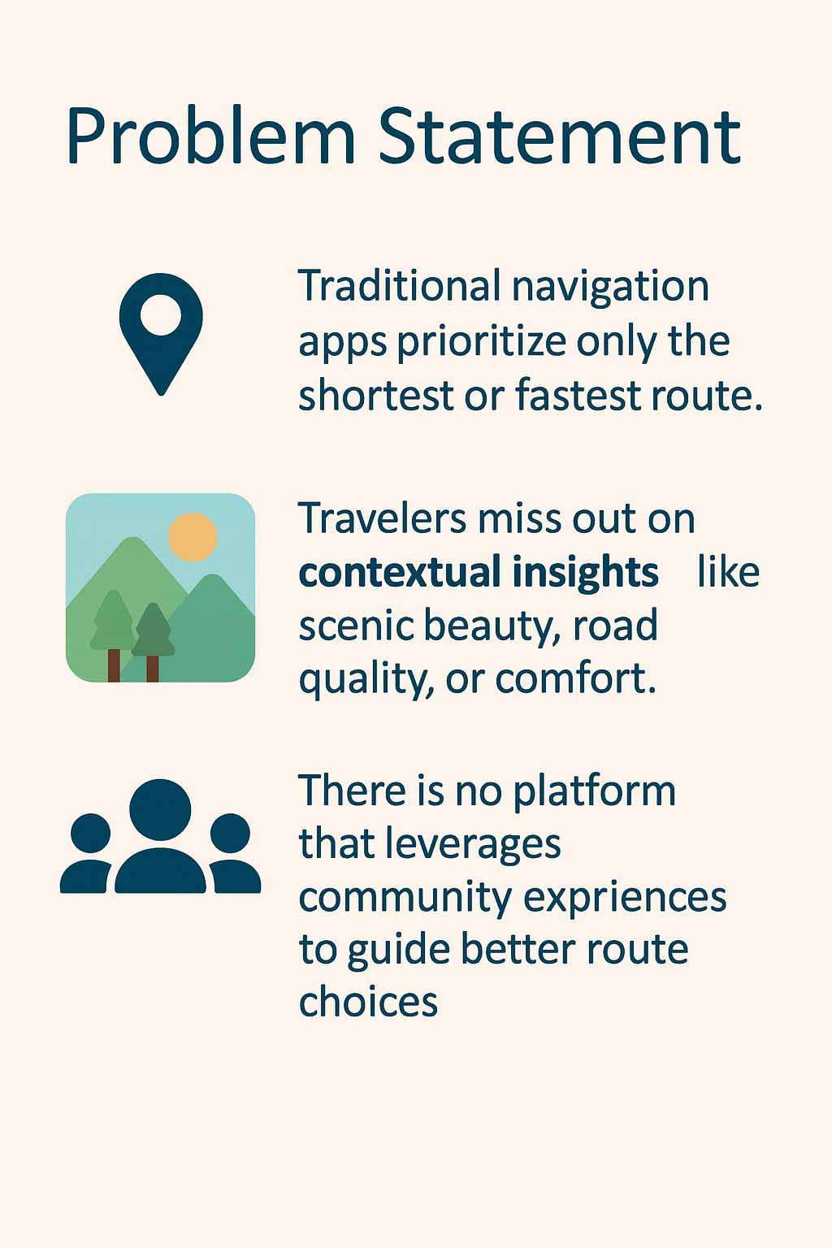

Slide 3
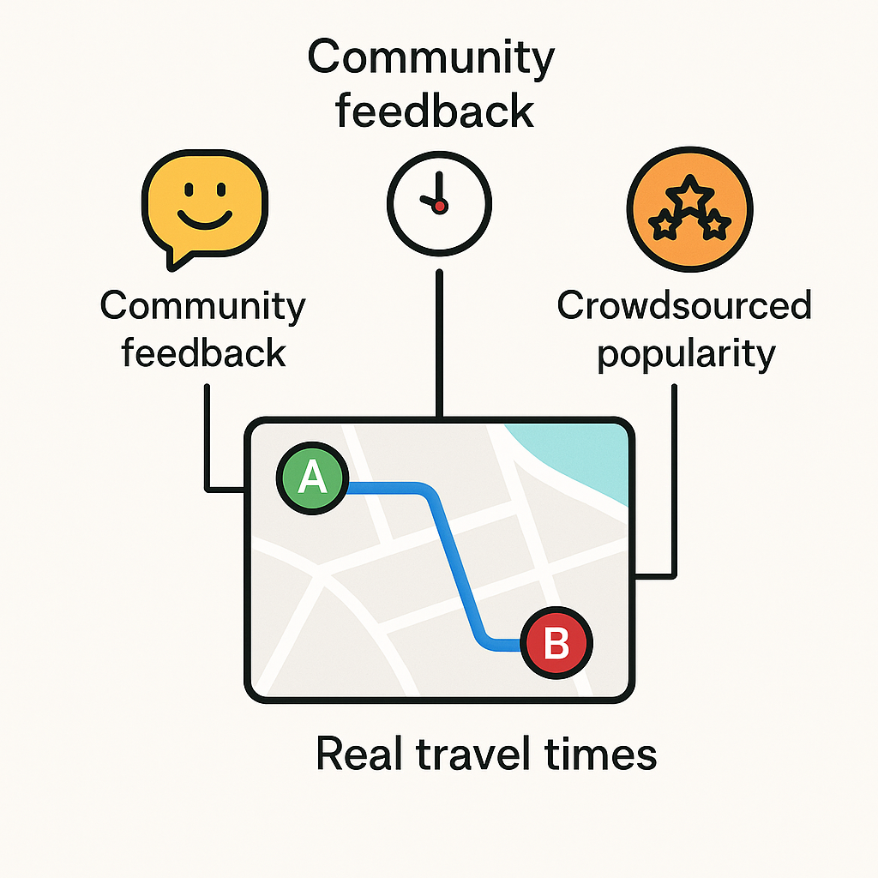
What is WalkWise?
WalkWise is a smart routing assistant
that enhances navigation using:
🌟 Community feedback on route
experience
🕒 Real travel times from actual users
📊 Crowdsourced popularity of
different paths

Slide 4
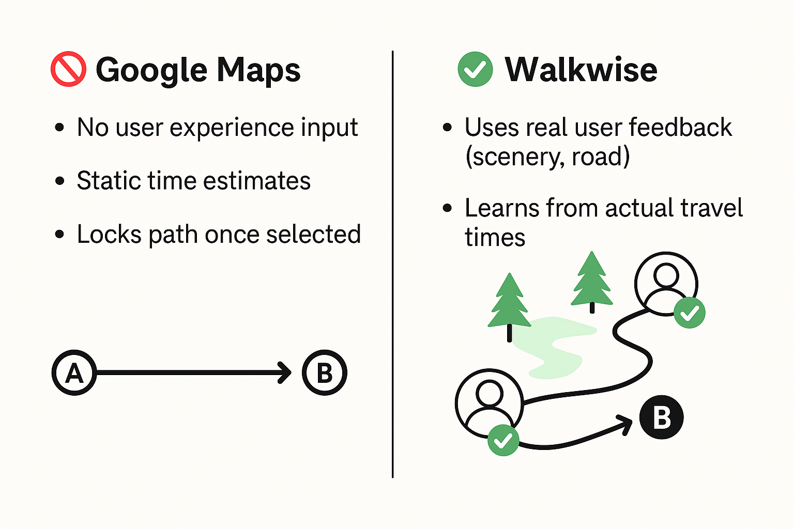
How It’s Different from Google Maps

Slide 5
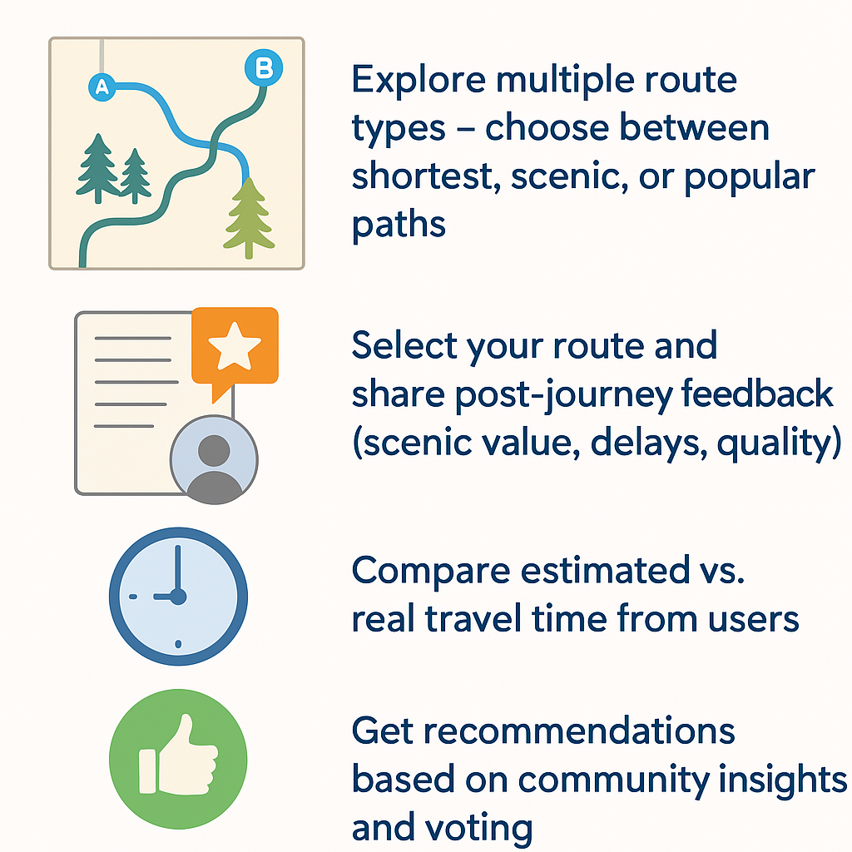
Core Features

Slide 6
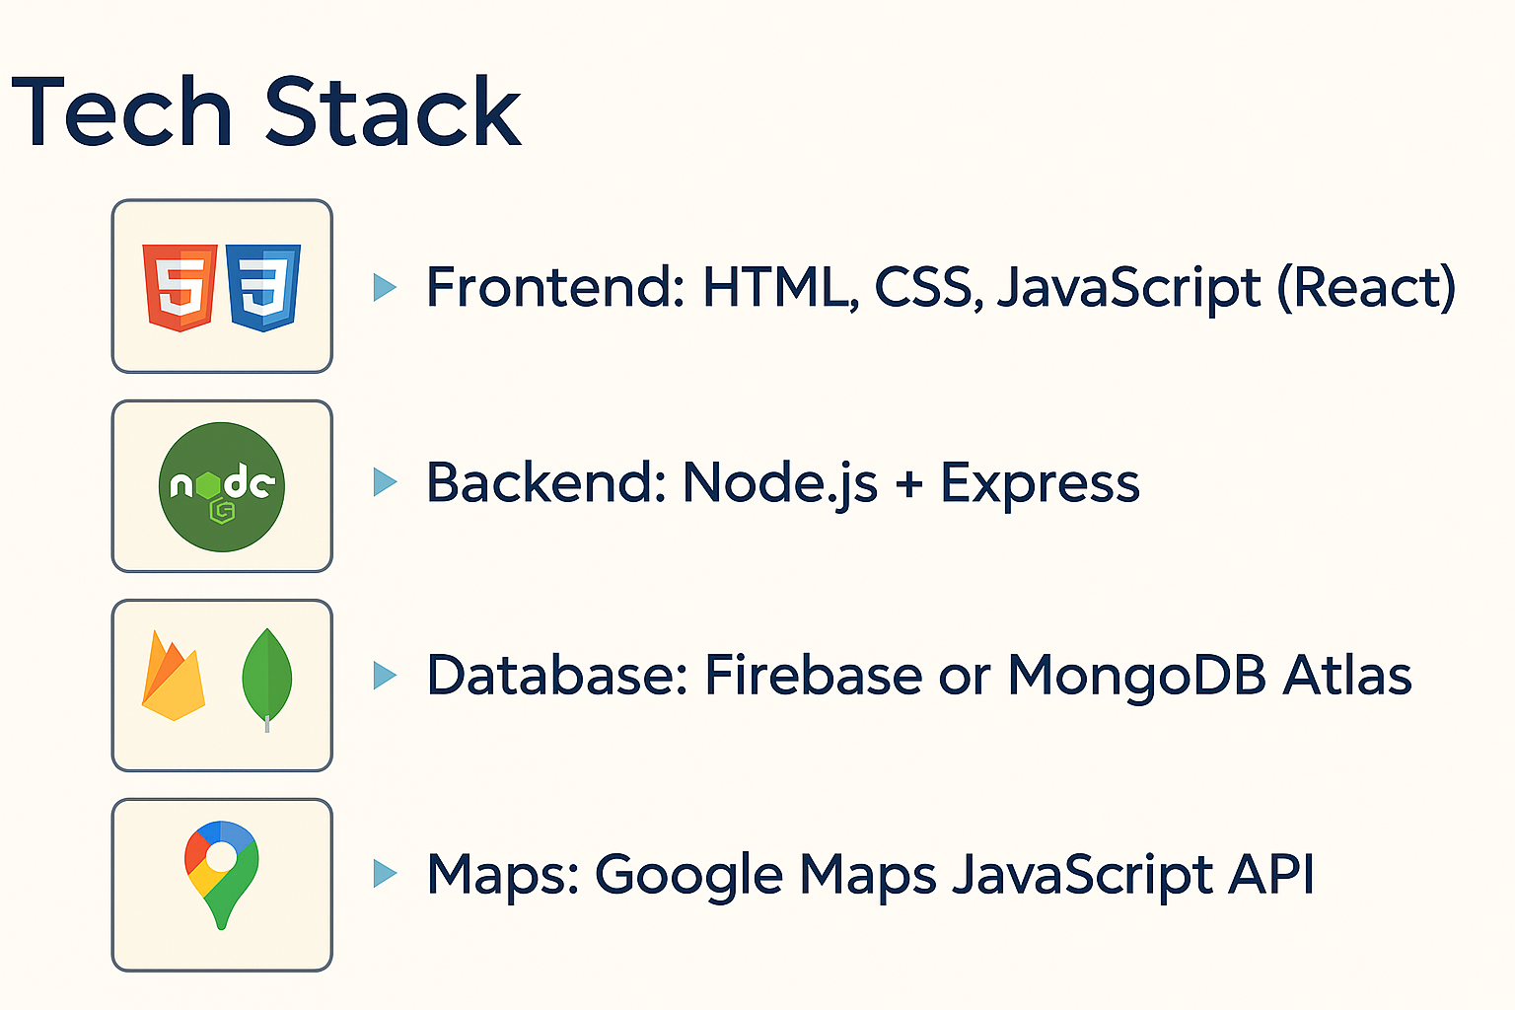

Slide 7

Smarter routes. Better journeys.
Let’s navigate your questions..
- Team Lumens💡

